Slide 1

ST.ANN’S COLLEGE OF ENGINEERING AND TECHNOLOGY,CHIRALA
DEPARTMENT OF CSE-CYBERSECURITY
REAL-TIME ANOMALY DETECTION IN IOMT NETWORKS USING STACKING MODEL AND A HEALTHCARE SPECIFIC DATASET
PROJECT GUIDE:
Mr. DR.SREERAM INDRANEEL
PROFESSOR
PROJECT COORDINATOR:
Mrs. M.LAKSHMI BAI
ASSOCIATE PROFESSOR
HEAD OF THE DEPARTMENT:
Mr. DR.SREERAM INDRANEEL
PROFESSOR
PRESENTED BY:
1. BANDLA KRISHNA PRIYA-(22F01A4606)
2. BONIGALA NANDINI-(22F01A4610)
3. BATTULA YUVA DURGA-(22F01A4607)
4. ASODI KEERTHI REDDY-(22F01A4603)
5. SHAIK SABEEHA-(22F01A4660)

Slide 2
LIST OF CONTENTS
Abstract
Introduction
Literature Survey
Objective
Existing System
Proposed System
Hardware Requirements
Software Requirements
Block Diagram
UML Diagrams
Modules Description
Algorithms used in the project
Implementation and Testing
Results
Conclusion
Future Extension

Slide 3
ABSTRACT
The Internet of Medical Things (IoMT) enables real-time healthcare monitoring and personalized treatment through interconnected medical devices however, it is vulnerable to cybersecurity threats such as data falsification and Denial-of-Service (DoS) attacks. Existing machine learning based anomaly detection approaches, including Random Forest, Extreme Gradient Boost (XGBoost), K-Nearest Neighbor (KNN), Support Vector Machine (SVM), and Artificial Neural Networks (ANN), enhance attack detection but suffer from limitations in computational efficiency and adaptability to diverse medical attack scenarios. To overcome these challenges, this work proposes a real-time anomaly detection system based on Light Gradient Boosting Machine (LightGBM). A novel medical cybersecurity dataset inspired by UNSW-NB15 and incorporating healthcare-specific attack patterns is developed for evaluation.

Slide 4
INTRODUCTION
The Internet of Medical Things (IoMT) has improved healthcare through real-time patient monitoring and smart medical devices. However, the connectivity of these devices also increases the risk of cyber attacks such as worms, reconnaissance, and fuzzers attacks. Traditional security methods are not suitable for IoMT due to limited device resources and strict time constraints. To address this issue, this study proposes a real-time anomaly detection system using a stacking ensemble machine learning model trained on healthcare data. The approach improves attack detection accuracy while maintaining low latency, helping to ensure secure and reliable IoMT networks.

Slide 5
LITERATURE SURVEY
Machine learning techniques such as Random Forest and KNN have shown strong performance in detecting anomalies in healthcare and IoMT data; however, many studies rely on fixed thresholds or simulated datasets, limiting real-world applicability. [1]
Unsupervised and semi-supervised approaches, including GAN(Generative Adversarial Network)-based labeling and clustering methods (KNN), reduce dependency on labeled data but often lack detailed dataset descriptions and real-time validation. [2]
Deep learning models such as CNNs, autoencoders, and stacked architectures achieve high accuracy in IoT anomaly detection, though they frequently suffer from high computational cost and limited explainability. [3]
Ensemble learning techniques (Bagging, Boosting, Voting, and Stacking) consistently outperform single models in IoMT and IoT intrusion detection but are rarely evaluated in real-time healthcare environments. [4]

Slide 6
LITERATURE SURVEY
Many intrusion detection studies rely on widely used general IoT datasets such as Bot-IoT, CICIDS, and UNSW-based datasets to evaluate model performance. Although these datasets effectively represent network-layer attacks, they fail to incorporate medical device behavior, patient physiological data, and healthcare-specific communication patterns. [5]
A significant portion of existing research focuses on detecting specific attack types such as DDoS, botnets, or flooding attacks. While these approaches often achieve high accuracy under controlled conditions, their specialization restricts their ability to generalize across diverse and evolving cyber threats commonly observed in healthcare networks. [6]
Current literature highlights gaps including lack of comprehensive medical datasets, limited real-time testing, and insufficient integration of healthcare data with network traffic motivating the need for hybrid datasets and robust stacking-based ensemble models. [7]

Slide 7
OBJECTIVE
To analyze security vulnerabilities and attack patterns in IoMT networks using real-world healthcare traffic data. It focuses on identifying threats that affect data integrity, confidentiality, and availability, while pre-processing and evaluating a healthcare-specific dataset to ensure balanced and relevant features for effective anomaly detection.

Slide 8
EXISTING SYSTEM
Random Forest (RF): Ensemble of decision trees for accurate classification.
Extreme Gradient Boost(XGBoost): Fast gradient boosting algorithm for high
performance detection.
K-Nearest Neighbor (KNN): Classifies data based on nearest neighbors.
Support Vector Machine (SVM): Separates classes using an optimal hyperplane.
Artificial Neural Network (ANN): Neural network model for learning complex
patterns.
Logistic Regression:A method used to classify data in to two Categories ,loke yes/No or Pass/Fail
Isolation Forest: A technique used to find unusual or abnormal data points in a dataset

Slide 9
PROPOSED SYSTEM
Light Gradient Boosting Machine (LightGBM):
LightGBM is a fast and efficient machine learning algorithm that uses decision trees to make accurate predictions. It is designed to handle large datasets with high speed and low memory usage, and it is commonly used for classification and regression tasks.

Slide 10
HARDWARE REQUIREMENTS
MINIMUM (Required for Execution) |  | MY SYSTEM (Development)
System | i2 processor | i5 Processor 12th Gen
Hard Disk | 20 Gb | 500 Gb
RAM | 1 Gb | 8 Gb

Slide 11
SOFTWARE REQUIREMENTS
Operating System | Windows 10/11
Development Software | Python 3.10
Programming Language | Python
Domain | Machine Learning
Integrated Development Environment (IDE) | Visual Studio Code
Front End Technologies | HTML5, CSS3, Java Script
Back End Technologies or Framework | Django
Database Language | SQL
Database (RDBMS) | MySQL
Database Software | WAMP or XAMPP Server
Web Server or Deployment Server | Django Application Development Server
Design/Modelling | Rational Rose

Slide 12
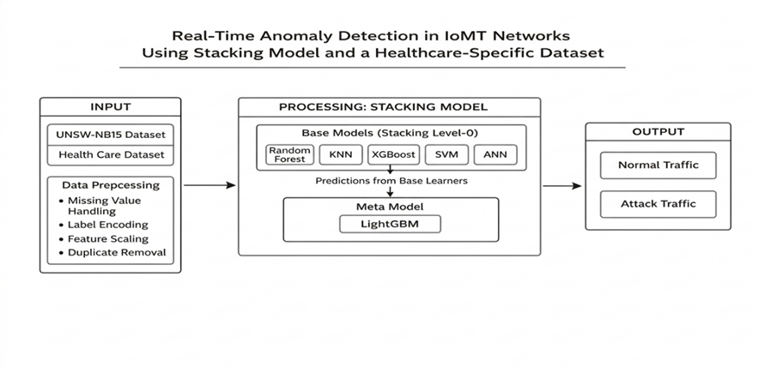
BLOCK DIAGRAM

Slide 13
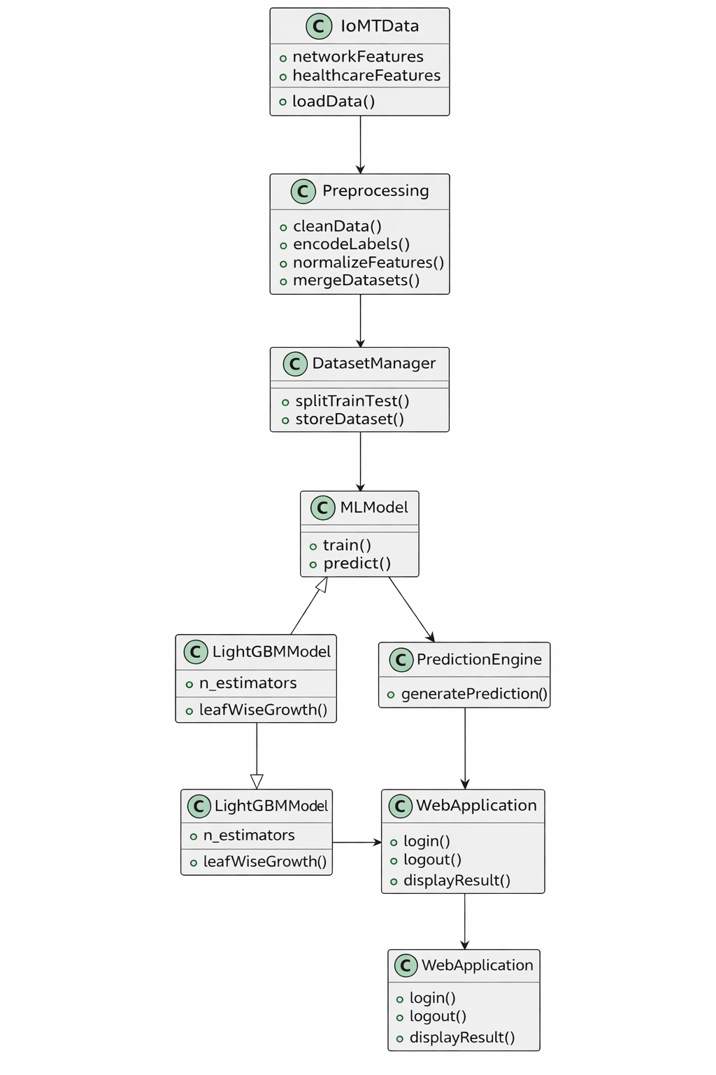
UML DIAGRAMS
CLASS DIAGRAM
A class diagram represents the static structure of a system by illustrating its classes, attributes, methods, and relationships. It provides a blueprint of how data and functionality are encapsulated within the system and how different components are logically connected.

Slide 14
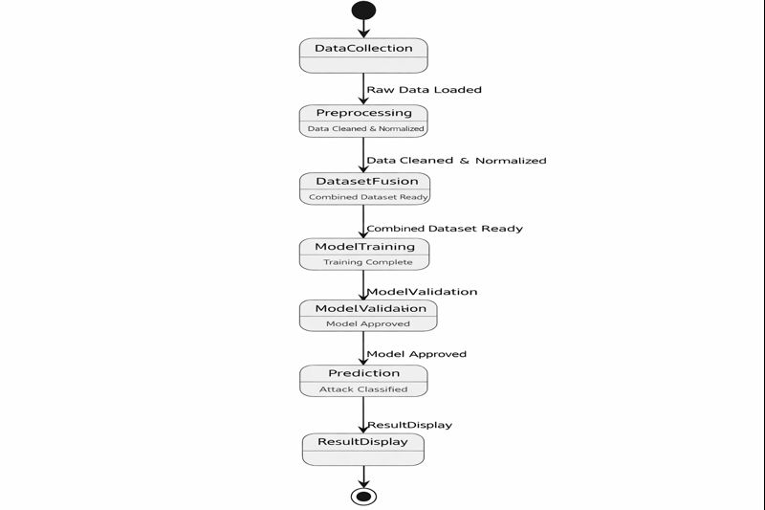
STATE DIAGRAM
A state diagram is a type of UML (Unified Modeling Language) diagram that shows the different states that the system (or a component of it) can be in, along with the transitions between those states based on events or conditions.

Slide 15
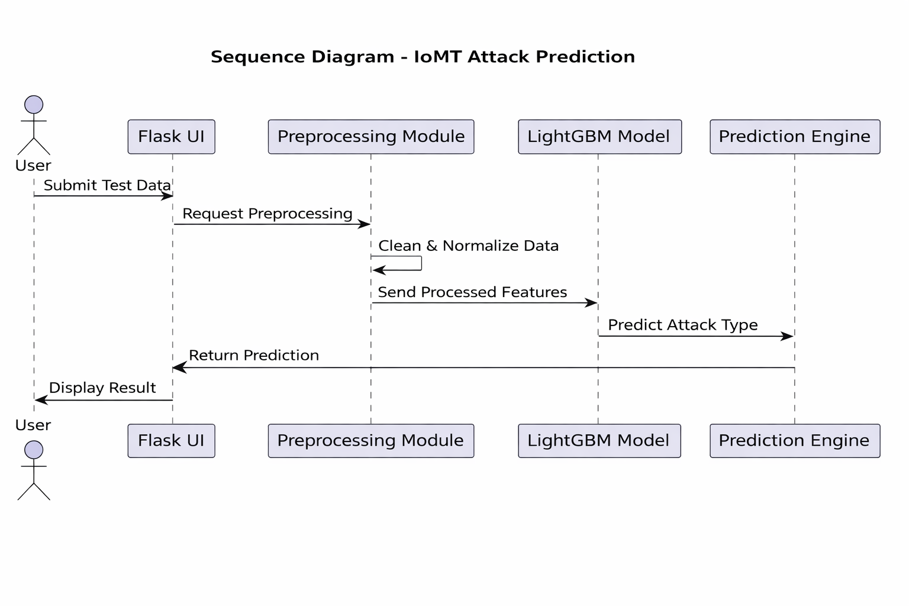
SEQUENCE DIAGRAM

Slide 16
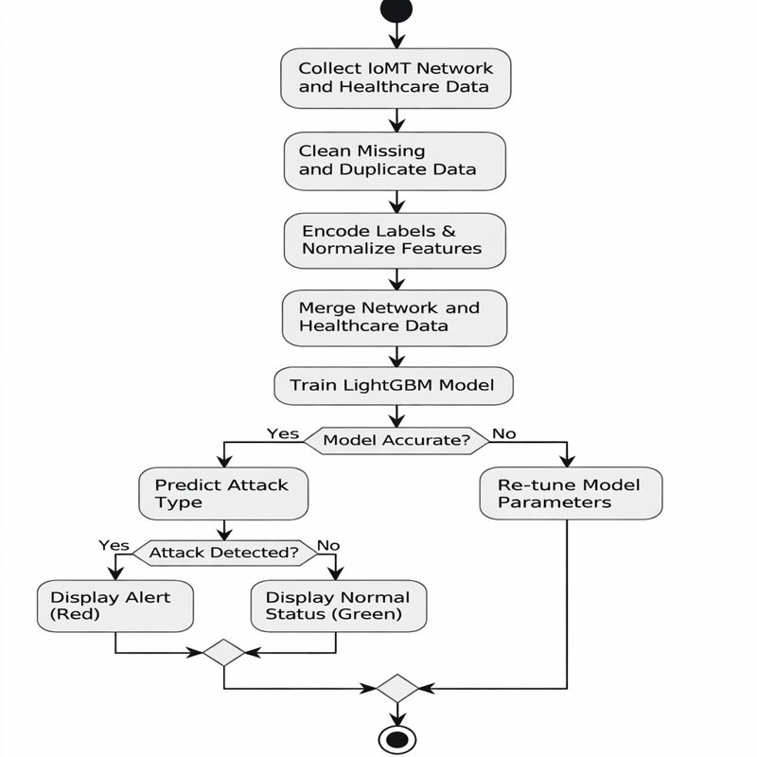
ACTIVITY DIAGRAM
An activity diagram represents the workflow of activities and decision points within a system. It focuses on the sequence of operations, including branching and parallel processing, rather than object interaction. In machine learning–based IoMT systems, activity diagrams are useful for visualizing the end-to-end process from data acquisition to anomaly detection and user notification.

Slide 17
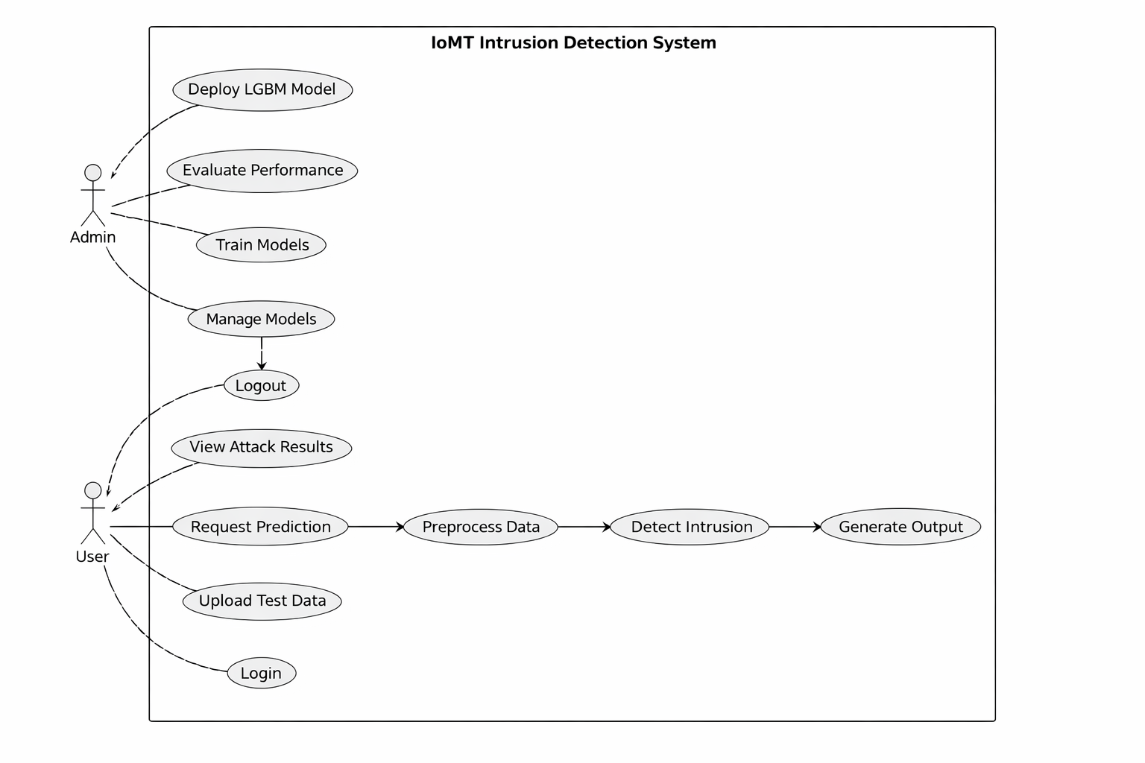
USE CASE DIAGRAM
A use case diagram describes what the system does from the user’s perspective. It identifies system functionalities (use cases) and shows how different actors interact with those functionalities. Use case diagrams are helpful for capturing functional requirements and defining system boundaries.

Slide 18
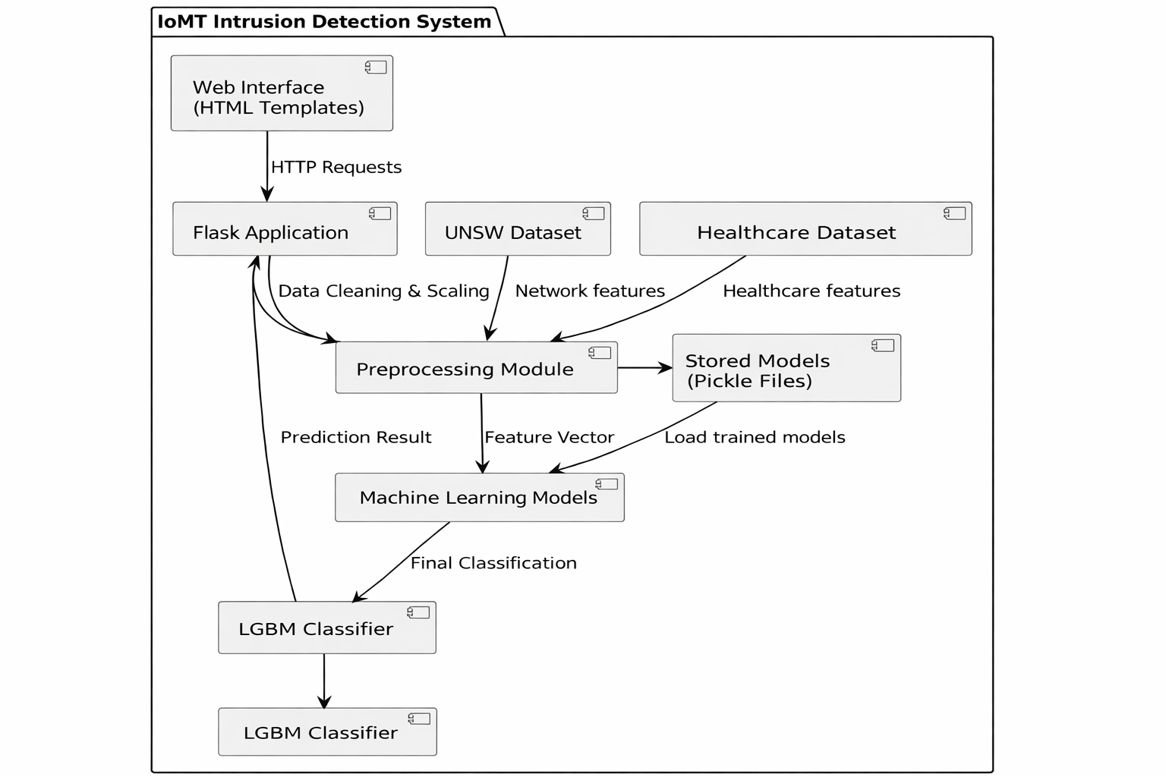
COMPONENT DIAGRAM
A component diagram illustrates the structural organization of a system, showing how software components interact through interfaces. It focuses on modularity, dependencies, and high-level architecture, making it useful for understanding system design and deployment structure.

Slide 19
MODULES DESCRIPTION
1.Data Handling & Preprocessing
1. Library & Environment Setup : Imports Pandas, NumPy, Scikit-learn, XGBoost, LightGBM, Matplotlib, Seaborn, Pickle, Flask; suppresses warnings.
2. Dataset Loading :
UNSW-NB15: Network traffic data for IoMT intrusion detection.
Healthcare Diabetes: Patient health indicators, downsized to match UNSW dataset.
3. Data Cleaning & Encoding : Label Encoding, duplicate removal, missing value imputation.
4. Feature Preparation : Normalization (StandardScaler), feature–target separation, train-test split, pre-saved dataset loading.
5. Dataset Fusion : Combines normalized healthcare and UNSW features for hybrid IoMT dataset.

Slide 20
MODULES DESCRIPTION
1.Model Training & Evaluation:
Metric Initialization & Calculation : Global lists for Accuracy, Precision, Recall, F1-score; calculateMetrics function for evaluation.
2. Machine Learning Models :
Classical & Ensemble: XGBoost, Random Forest, Logistic Regression, KNN, SVM
Anomaly Detection: Isolation Forest
Neural Networks: ANN (MLP)
Meta/Extension Models: Soft Voting Classifier, LightGBM
3. Model Persistence : Saves and loads trained models using Pickle for reuse.
4. Performance Visualization & Summary : Bar charts and Pandas DataFrame for metric comparison across algorithms.

Slide 21
MODULES DESCRIPTION
Web Deployment & Prediction
1. Flask App Initialization – Security keys, dataset reload, preprocessing, model retraining.
2. Routes & Functions –
index – Homepage
predictView – Prediction page
UserLogin & UserLoginAction – User authentication
Logout – Logs out user
PredictAction – Preprocesses test data, runs LightGBM model, displays results dynamically.
3. Real-time Deployment – Flask server enables browser-based IoMT intrusion detection with visual threat indication.

Slide 22
ALGORITHMS USED IN THE PROJECT
Algorithm Used - Light GBM
Builds an ensemble of decision trees sequentially, where each tree corrects the errors of previous trees.
Employs a leaf-wise tree growth strategy that expands the leaf with maximum loss reduction, enabling deeper pattern learning.
Uses histogram-based feature discretization to significantly reduce computational cost and memory usage.
Achieves fast training and high predictive accuracy, making it suitable for intrusion detection tasks.

Slide 23
Algorithm Steps – LightGBM
Initialize the model with a baseline prediction.
Compute loss gradients for all training samples.
Select the leaf with the maximum loss reduction.
Split the selected leaf using the most informative feature threshold.
Update predictions by adding the newly trained tree.
Repeat the process until the stopping criteria are met.
Combine all trees to produce the final classification output.

Slide 24
IMPLEMENTATION
The UNSW-NB15 intrusion dataset and healthcare-related data were collected and merged to represent realistic IoMT traffic scenarios.
Data preprocessing was performed, including handling missing values, label encoding of categorical features, and normalization to ensure uniform feature scaling.
Feature selection was applied to remove irrelevant and redundant attributes, improving model efficiency and reducing computational overhead.
Multiple baseline machine learning models were implemented for performance comparison, followed by the proposed LightGBM-based Meta Model.
The LightGBM classifier was trained using a leaf-wise tree growth strategy and histogram-based learning for faster convergence and improved accuracy.
The final trained model was integrated into a classification pipeline to detect normal and attack traffic in IoMT environments.

Slide 25
TESTING
The dataset was divided into training and testing sets to ensure unbiased performance evaluation.
Functional testing was conducted to verify correct data flow through preprocessing, training, and prediction stages.
The model was evaluated using standard performance metrics such as accuracy, precision, recall, and F1-score.
Comparative testing was performed between baseline models and the proposed LightGBM Meta Model to validate performance improvement.
Stress testing was carried out using multiple attack categories to assess robustness against diverse intrusion patterns.
Result analysis confirmed the reliability and consistency of the proposed model for IoMT anomaly detection.

Slide 26
RESULTS
The proposed system was tested using unseen and preprocessed network traffic data.
Each input sample contains normalized feature values extracted from network flows.
The trained model classifies traffic into Normal and multiple attack categories.
The attack Categories Identified by the system include:
DoS,Worms,Reconnaissance
The model successfully distinguishes normal traffic from malicious traffic.
It also accurately differentiates between various attack types based on learned patterns.
The results indicate that the system supports multi-class intrusion detection rather than simple binary classification.
This demonstrates the effectiveness of the model in identifying diverse network attacks in real-world scenarios.

Slide 27
CONCLUSION
Integration of healthcare indicators with network traffic significantly enhances IoMT anomaly detection performance.
Standalone models like ANN showed limited generalization on complex IoMT data.
The proposed LightGBM-based Meta Model achieved superior accuracy, precision, recall, and F1-score.
High recall ensures effective detection of diverse cyberattacks with reduced false negatives.
The framework is scalable, reliable, and suitable for real-time IoMT cybersecurity deployment.

Slide 28
FUTURESCOPE
Integration of real-time streaming frameworks (e.g., Apache Kafka, MQTT) to enable continuous and live intrusion monitoring in IoMT environments.
Extension of the model to support adaptive learning, allowing dynamic response to evolving and unseen cyberattack patterns.
Exploration of advanced deep learning architectures such as Graph Neural Networks (GNNs) and Transformer-based models to capture temporal and relational dependencies among IoMT devices.
Implementation of automated hyperparameter optimization techniques to enhance detection accuracy and reduce manual tuning efforts.
Incorporation of Explainable AI (XAI) methods to improve model interpretability, transparency, and trustworthiness in healthcare applications.
Deployment and evaluation of the system in large-scale, real-world IoMT settings to validate scalability and robustness.

Slide 29
REFERENCES
[1] E. Šabić, D. Keeley, B. Henderson, and S. Nannemann, “Healthcare and anomaly detection: Using machine learning to predict anomalies in heart rate data,” AI & Society, vol. 36, no. 1, pp. 149–158, May 2020, doi: 10.1007/s00146-020-00985-1.
[2] S. Park, K. H. Lee, B. Ko, and N. Kim, “Unsupervised anomaly detection with generative adversarial networks in mammography,” Sci. Rep., vol. 13, no. 1, pp. 1–10, Feb. 2023, doi: 10.1038/s41598-023-29521-z.
[3] M. Kavitha, P. V. V. S. Srinivas, P. S. L. Kalyampudi, S. F. Choragudi, and S. Srinivasulu, “Machine learning techniques for anomaly detection in smart healthcare,” in Proc. 3rd Int. Conf. Inventive Research in Computing Applications (ICIRCA), Sep. 2021, pp. 1350–1356.
[4] L. Fang, Y. Li, Z. Liu, C. Yin, M. Li, and Z. J. Cao, “A practical model based on anomaly detection for protecting medical IoT control services against external attacks,” IEEE Transactions on Industrial Informatics, vol. 17, no. 6, pp. 4260–4269, Jun. 2021, doi: 10.1109/TII.2020.3011444.
[5] T. Alsolami, B. Alsharif, and M. Ilyas, “Enhancing cybersecurity in healthcare: Evaluating ensemble learning models for intrusion detection in the Internet of Medical Things,” Sensors, vol. 24, no. 18, p. 5937, Sep. 2024, doi: 10.3390/s24185937.
[6] A. A. Hady, A. Ghubaish, T. Salman, D. Unal, and R. Jain, “Intrusion detection system for healthcare systems using medical and network data: A comparison study,” IEEE Access, vol. 8, pp. 106576–106584, 2020, doi: 10.1109/ACCESS.2020.3000421.
[7] I. Ullah and Q. H. Mahmoud, “Design and development of a deep learning-based model for anomaly detection in IoT networks,” IEEE Access, vol. 9, pp. 103906–103926, 2021, doi: 10.1109/ACCESS.2021.3094024.

Slide 30
THANKYOU

